Slide 1

LarIAT Rent-A-Car Finance Summary and Profit Optimization Strategies
Tedman Zhuang
05/2022

Slide 2
2018 Lariat Action plan
2019 Strategy Guide
2018 Summary
Number of Vehicles | 4000
Gross Revenue | $52,830,207.00
Average Revenue per Vehicle | $13,207.55
Gross Vehicle Cost | $ 28,244,305.68
Gross Insurance Cost | $402,698.58
Total Cost | $ 28,647,004.26
Net Revenue | $24,183,202.74
Goal: Increase 2019 profit using assumptions from 2018 data.
Strategy 1: Increase the volume of all vehicles
Strategy 2: Remove all vehicles with negative profit
Strategy 3: Increase volume of vehicles that have the highest profit from 2018

Slide 3
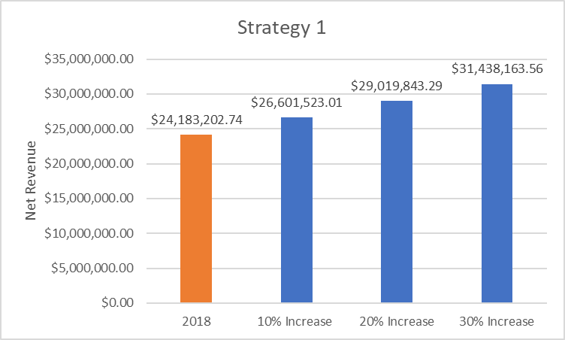
Strategy 1 Models and summary
 | 2018 | Strategy 1 (40% increase)
Number of Vehicles | 4000 | 5600
Gross Revenue | $52,830,207.00 | $73,962,289.80
Average Revenue per Vehicle | $13,207.55 | $13,207.55
Gross Vehicle Cost | $ 28,244,305.68 | $39,542,027.95
Gross Insurance Cost | $402,698.58 | $563,778.01
Total Cost | $ 28,647,004.26 | $40,105,805.96
Net Revenue | $24,183,202.74 | $33,856,483.84
Net Difference | - | $9,673,281.10
Strategy Summary
Easy to understand - Net revenue for 2019 increases by the number of new vehicles multiplied by 2018 average revenue per vehicle
Easy to Implement - Proportionally increase inventory of all vehicles
Not optimal - Should we increase inventory for all vehicles?

Slide 4
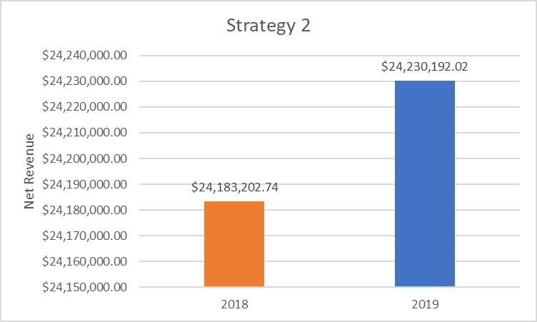
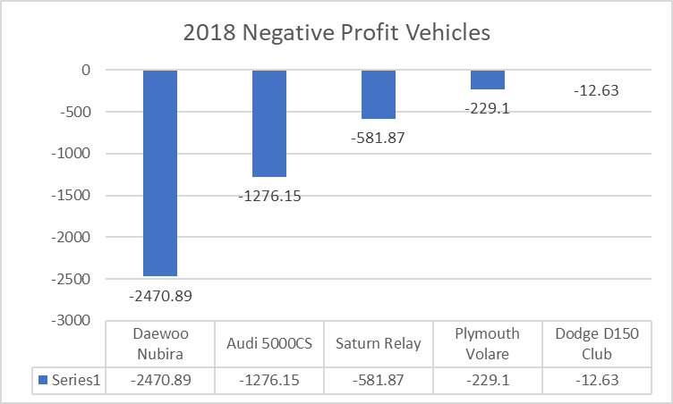
Strategy 2 Models and summary
 | 2018 | Strategy 2
Number of Vehicles | 4000 | 3995
Gross Revenue | $52,830,207.00 | $52,834,777.64
Average Revenue per Vehicle | $13,207.55 | $13,225.23
Gross Vehicle Cost | $ 28,244,305.68 | $28,202,371.08
Gross Insurance Cost | $402,698.58 | $402,214.54
Total Cost | $ 28,647,004.26 | $28,604,585.62
Net Revenue | $24,183,202.74 | $24,230,192.02
Net Difference | - | $46,989.28
Strategy Summary
Easy to understand - Net revenue for 2019 increases by removing all vehicles with negative net revenue in 2018
Easy to Implement - Simply remove all vehicles with negative revenue
Very Optimal - Cutting all wasted costs
Downsides - Relatively small increase in net revenue
Alternatives

Slide 5
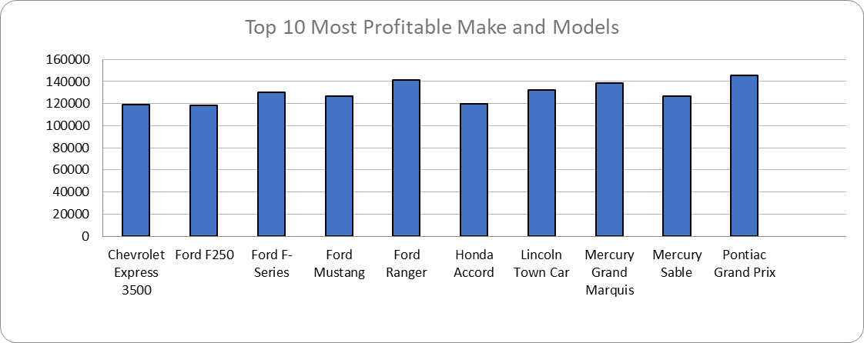
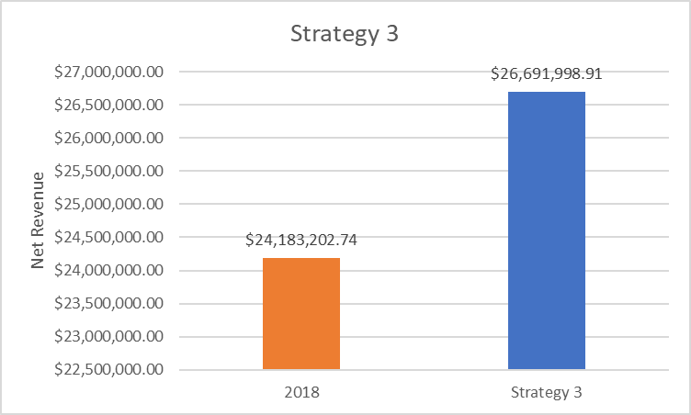
Strategy 3 Models and summary
 | 2018 | Strategy 3
Number of Vehicles | 4000 | 4387
Gross Revenue | $52,830,207.00 | $58,093,374.50
Average Revenue per Vehicle | $13,207.55 | $13,242.16
Total Additional Revenue of Top 50 profit Make/Models |  | $ 5,263,167.50
Gross Vehicle Cost | $ 28,244,305.68 | $ 28,244,305.68
Gross Insurance Cost | $402,698.58 | $402,698.58
Total Additional Cost of Top 50 profit Make/Models |  | $ 2,754,371.34
Total Cost | $ 28,647,004.26 | $ 31,401,375.60
Net Revenue | $24,183,202.74 | $26,691,998.91
Difference in Revenue | $0.00 | $2,508,796.17
Strategy Summary
Easy to Implement – Increase inventory of top 50 highest profitable Makes/Models
Optimal – Targeting increases on high performing vehicles
Flexible
Some Alternatives

Slide 6
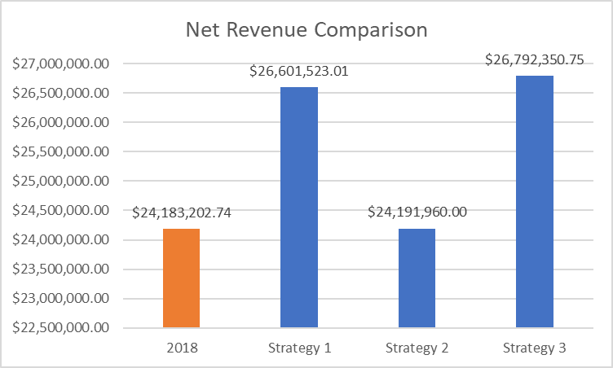
Strategy Comparisons
Strategy Summary
 | 2018 | Strategy 1 | Strategy 2 | Strategy 3
Number of Vehicles | 4000 | 4400 | 3995 | 4402
Gross Revenue | $52,830,207.00 | $58,113,227.70 | $52,830,219.63 | $58,303,901.20
Average Revenue per Vehicle | $13,207.55 | $13,207.55 | $13,224.09 | $13,244.87
Total Additional Revenue of Top 50 profit Make/Models |  |  |  | $ 5,473,694.20
Gross Vehicle Cost | $ 28,244,305.68 | $ 31,068,736.25 | $ 28,235,611.20 | $ 28,244,305.68
Gross Insurance Cost | $402,698.58 | $442,968.44 | $402,648.43 | $402,698.58
Total Additional Cost of Top 50 profit Make/Models |  |  |  | $ 2,864,546.19
Total Cost | $ 28,647,004.26 | $ 31,511,704.69 | $ 28,638,259.63 | $ 31,511,550.45
Net Revenue | $24,183,202.74 | $26,601,523.01 | $24,191,960.00 | $26,792,350.75
Difference in Revenue | $0.00 | $2,418,320.27 | $8,757.26 | $2,609,148.01
Growth |  | 10% | 0.0362% | 10.7891%
Strategy Comparison Summary
Numbers for strategy 1 and 3 are based on 10% increase in inventory
Strategy 3 highest increase in net revenue

Slide 7
Recommendations and Alternatives
Based on this analysis, I would recommend a combination of Strategy 2 and 3
Alternative Strategies – Increase inventory for vehicles with highest average profit, replace vehicles with lower profit with more successful ones
Why not only offer most successful vehicles? – Diversity is important
Some things to possibly look into – Vehicles with most accidents, Branch Location impact, Airport impact

Slide 8
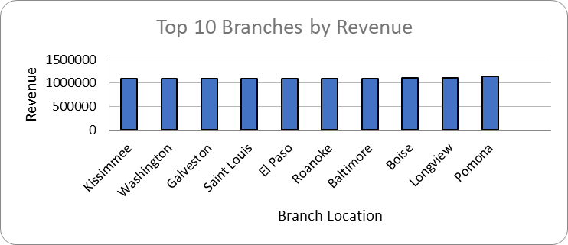
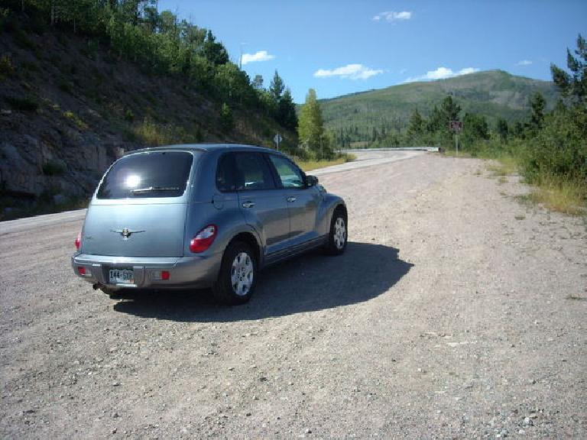
Branch Analysis
Avg Branch Revenue | $1,056,595.26
Avg Airport Branch Revenue | $1,055,078.59
Avg Non-Airport Branch Revenue | $1,057,786.93
Avg # Accidents | 81
Avg Days Rented | 6512
This Photo by Unknown Author is licensed under CC BY

